Slide 1
Welcome to my project

Slide 2
MST.Rahima khatun
Batch :50
Roll:01-050-13

Slide 3

What is Microsoft excel?
Microsoft Excel is a spreadsheet editor developed by Microsoft for Windows, macOS, Android, iOS and iPadOS. It features calculation or computation capabilities, graphing tools, pivot tables, and a macro programming language called Visual Basic for Applications (VBA). Excel forms part of the Microsoft 365 suite of software.
Excel Symbol :

Slide 4
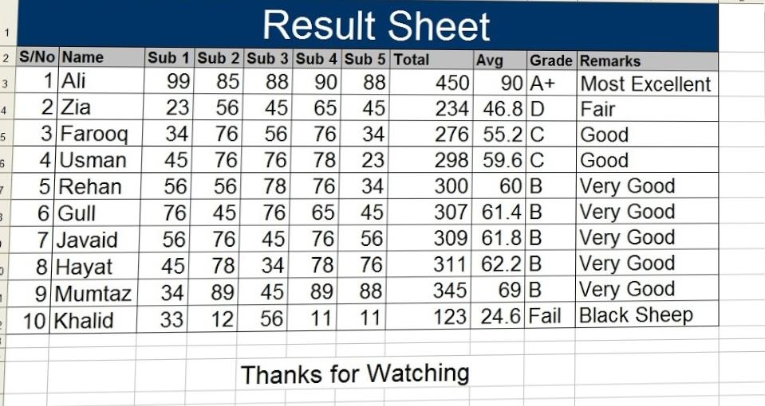
Microsoft Excel Example :

Slide 5
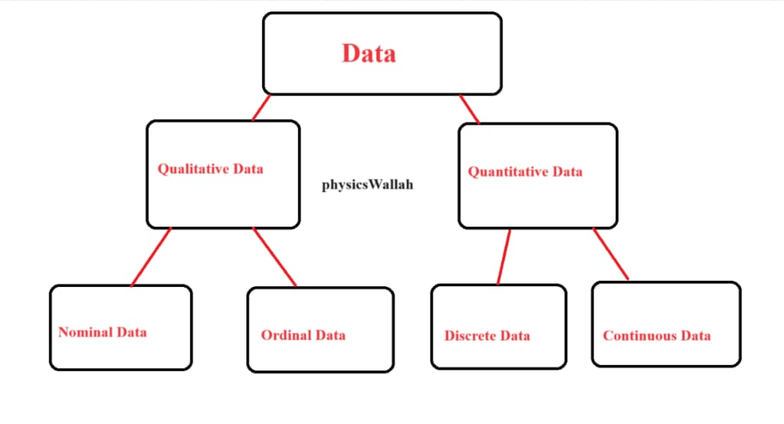
How many types of cxcel are there?
Data Types in MS Excel: There are 4 types of Excel data types with different values in Microsoft Excel. The four types of data are nominal,ordinal, discrete and continuous . Excel is the most used spreadsheet programme despite the fact that there are several.

Slide 6
Advanced Excel Formulas.
1.Index match.
2.If combined with AND/OR.
3.Offset combined with SUM or Average.
4.Choose.
5.Sumif and Countif.

Slide 7
Disadvantage of Excel.
Limited collaboration capabilities.
Poor handling of large datasets.
Lack of integrated project management features.
Limited visual project tracking tools.
Absences of automation features.

Slide 8
Bold,underline,Italic
There are many types of microscopes, and they may be grouped in different ways. One way is to describe the method an instrument uses to interact with a sample and produce images, either by sending a beam of light or electrons through a sample in its optical path, by detecting photon emissions from a sample, or by scanning across and a short distance from the surface of a sample using a probe. The most common microscope (and the first to be invented) is the optical microscope, which uses lenses to refract visible light that passed through a thinly sectioned sample to produce an observable image. Other major types of microscopes are the fluorescence microscope, electron microscope (both the transmission electron microscope and the scanning electron microscope) and various types of scanning probe microscopes.

Slide 9
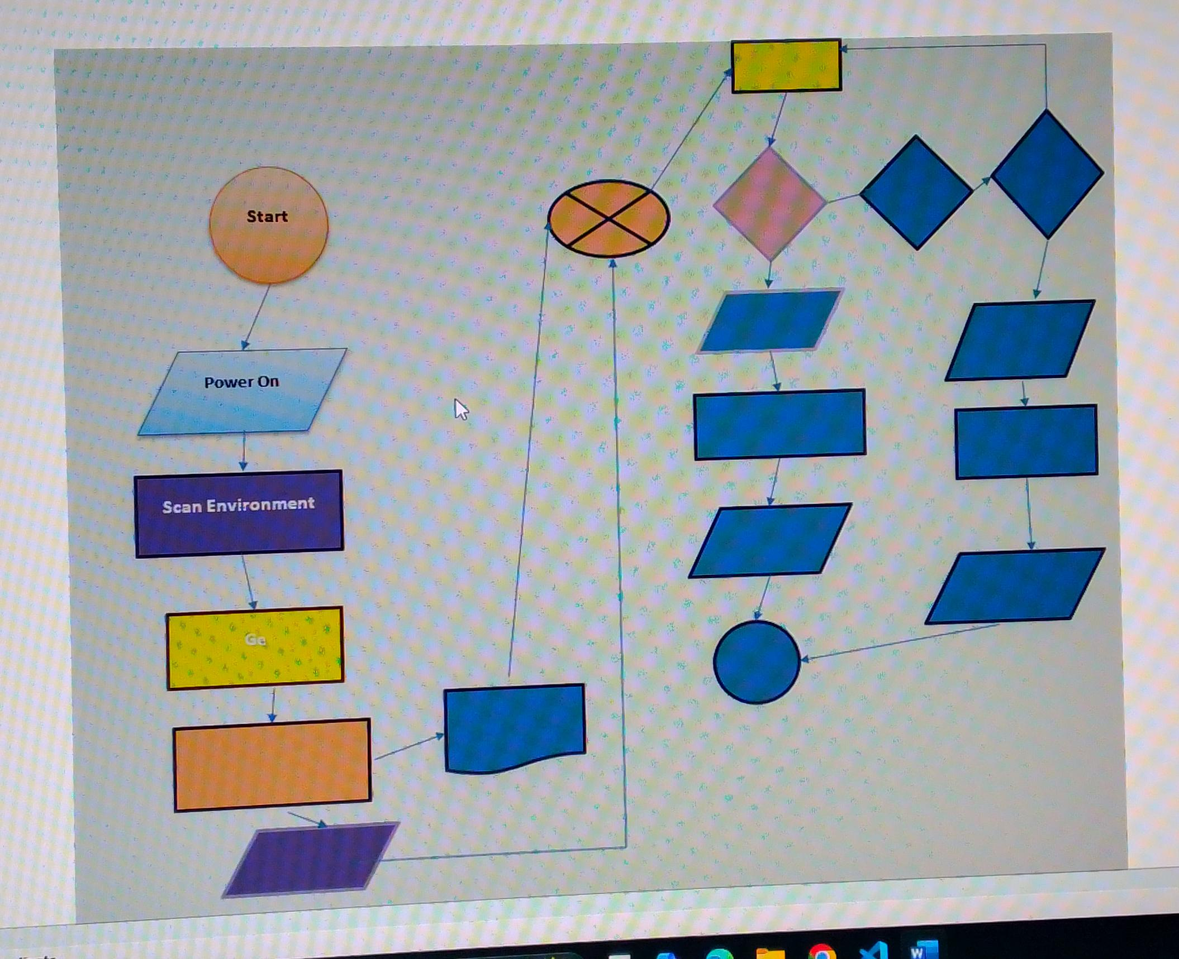
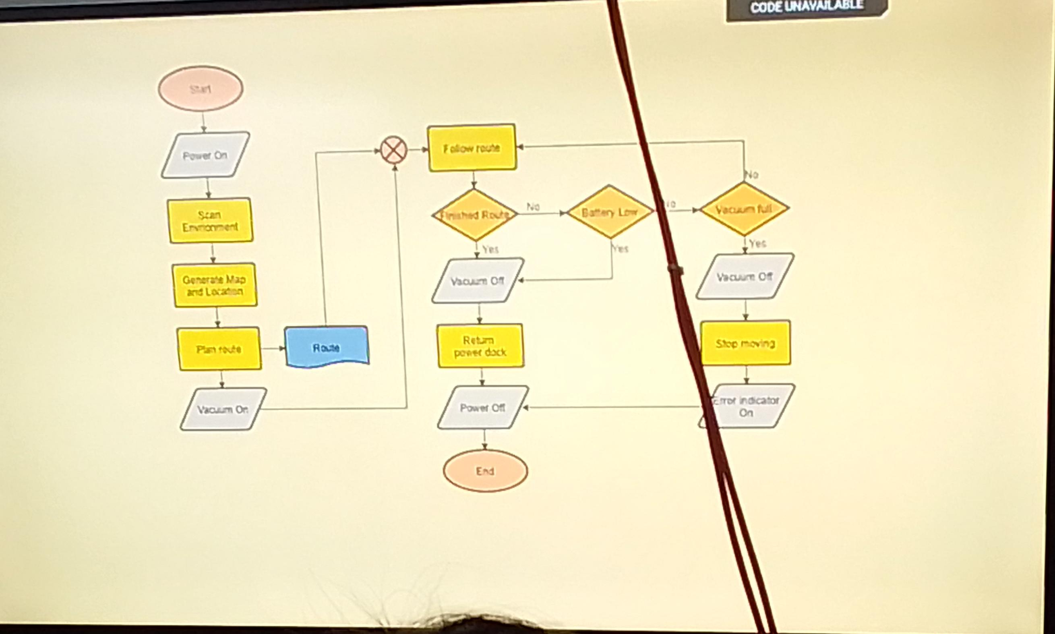
Design,Shape

Slide 10
Table
Alpa rays | Beta rays | Gamma rays
Alpa ray are doubly ionized helium atom. | Beta rays consist of ordinary electrons. | Gamma ray are electronegative radiation.
Alpa ray carries positive charge. | Beta ray carry negative charge. | They have no charge.
Affected photographic plate. | Affected photographic plate | Affected photographic plate

Slide 11
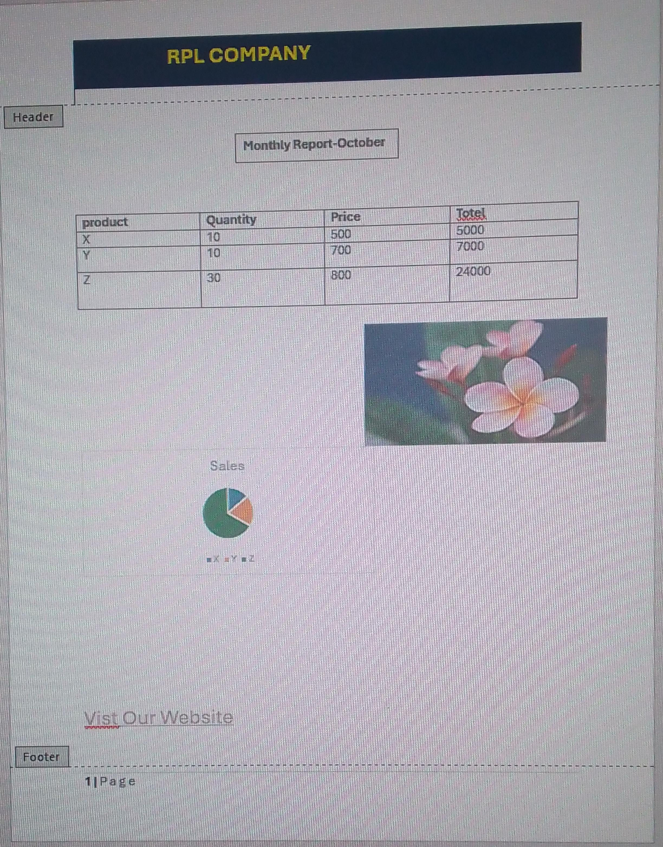
Header & footer,image setting

Slide 12
Thank you

